Slide 1
Recitation 6
Inheritance

Slide 2
Terms
Superclass: A class from which one ore more classes are derived.
Subclass: A class that inherits from a superclass

Slide 3
Terms
Overriding: When a subclass has the same method as a superclass
Super keyword: Used to access superclass methods from the the subclass.
Not needed if the method isn’t overridden in the current class. In that case you can call it directly by its name as if it were declared in the current class.

Slide 4
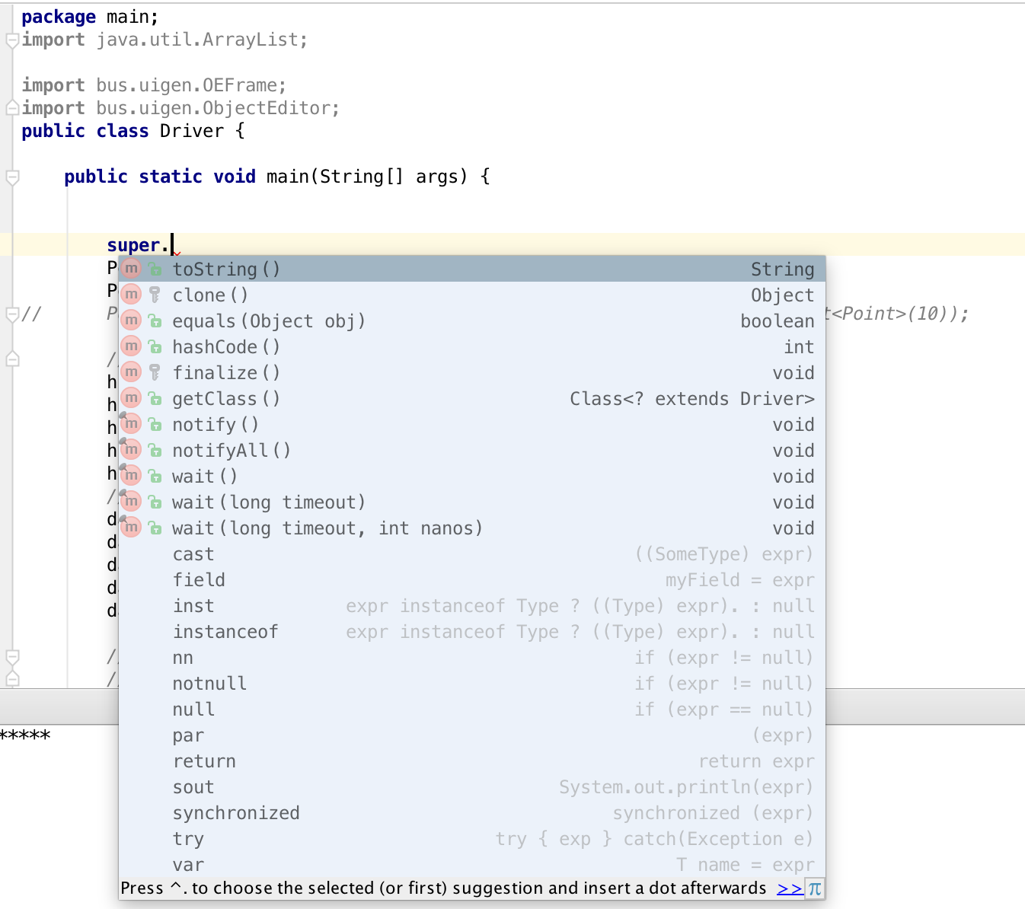
Object Class
Is Extended by Everything!

Slide 5
Program explanation
The program is derived from AStringHistory and AStringDatabase, which can be found in the JavaTeacing repository. Instead of storing strings, this program stores points. There are 2 different implementations, APointHistory and APointDatabase
Generally, both of the two classes can take 2 integer values as arguments. Then they create a point by the 2 values and store it in their properties. APointDatabase extends APointHistory and has 3 new methods, remove(), member(), and clear();
Class APointHistoryUsingArrayList is another implementation of PointHistory. It uses an arraylist, instead of a pre-defined array, to store points. The good part of arrayList is the size of an arraylist can be changed dynamically according to number of element.

Slide 6
Play Around with the Driver
Type cast: because APointDatabase extends APointHistory, can we convert a class, which type is APointDatabase, into APointHistory? Or can we do this inversely?
getClass() and getSuperclass(): check the code using getClass() and getSuperclass() (in line 29 to line31) and their outputs. Try to use these two methods with other classes. Can you generalize what are the results of the two methods?
Override: notice that there are 2 different toString() methods in APointDatabase, one calls super and the other does not. Test the results of both methods and see how keyword super works. And comment out both methods and see the output.

Slide 7
Play Around with the Driver
instanceof operator: line 42 to line 45 in Driver class tests the instanceof operator. The instanceof operator takes two operands and returns a boolean value. Basically it checks whether or not a given object is an instance of a class. Tricky thing: we know that APointDatabase extends APointHistory, so what is the result of database instanceof APointHistory?
Comment out line 9 and remove the comment sign of line 11, test the arrayList implementation of APointHistory, get some familiarity of arrayList.

Slide 8
To Submit
After you're done experimenting, rewrite the main method to have a few of your own statements that use "instanceof", "getClass()", and an overriden "toString()" method. Take a screenshot of your code and the console output and submit it on Sakai

Slide 9
Resources
Arraylist: http://docs.oracle.com/javase/6/docs/api/java/util/ArrayList.html
Instanceof: http://stackoverflow.com/questions/7526817/use-of-instance-of-in-java
getClass() and getSuperclass(): http://docs.oracle.com/javase/6/docs/api/java/lang/Object.html

